Slide 1
Topics covered​
Classification
Naïve Bayes
Bayes model​
K-means
EM Algorithm
Gaussian Mixture Model

Slide 2
Machine Learning​
Archit Kumar

Slide 3
Introduction​
Machine learning is the science of getting computers to act without being explicitly programmed.
It is a subset of artificial intelligence that often uses statistical techniques to give computers the ability to "learn" (i.e., progressively improve performance on a specific task) with data, without being explicitly programmed.
Supervised learning 1. Semi-supervised learning 2. Active Learning 3. Reinforcement Learning
Unsupervised learning
Notes:
In the past decade, machine learning has given us self-driving cars, practical speech recognition, effective web search, and a vastly improved understanding of the human genome. Also smart robots (perception, control), spam detection, computer vision, medical informatics, Audio, database mining.

Slide 4
Introduction​-continued
Supervised learning includes parametric/non-parametric algorithms, support vector machines, kernels, neural networks.
Unsupervised learning includes clustering, dimensionality reduction, recommender systems, deep learning.

Slide 5
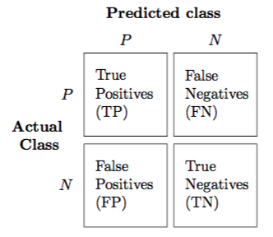
Results Analysis
Confusion Matrix:
True Positive (TP) : Observation is positive, and is predicted to be positive.
False Negative (FN) : Observation is positive, but is predicted negative.
True Negative (TN) : Observation is negative, and is predicted to be negative.
False Positive (FP) : Observation is negative, but is predicted positive.

Slide 6
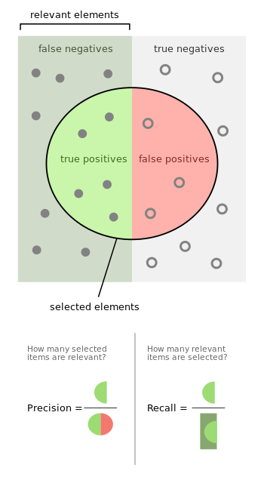
Results Analysis​ - continued
The object is classified either correctly or incorrectly.
Accuracy is the proportion of true results (both true positives and true negatives) among the total number of cases examined.
Precision is the fraction of relevant instances among the retrieved instances
Recall is the fraction of relevant instances that have been retrieved over the total amount of relevant instances.
F-measure(F₁ score) is the harmonic mean of precision and recall

Slide 7
Data​
Data is divided into Training and Testing to train and test our ML model.
Dataset has to be generated in some cases. During data cleansing, the attributes best describing the data must be kept. This can be determined using data correlation.
The data can be sequential (dynamic) or static.
1. Static data: Scene Image
2. Dynamic data: Audio file
Understanding the data is important and accordingly a best fit ML Model is applied.
Notes:
Correlation not done, but used to see if the attributes used are actually useful

Slide 8
Distribution of Data
Normal
Exponential
Poisson
Binomial…
Data can be continuous or discrete.
Notes:
Correlation used to see if the attributes used are actually useful to train the model

Slide 9
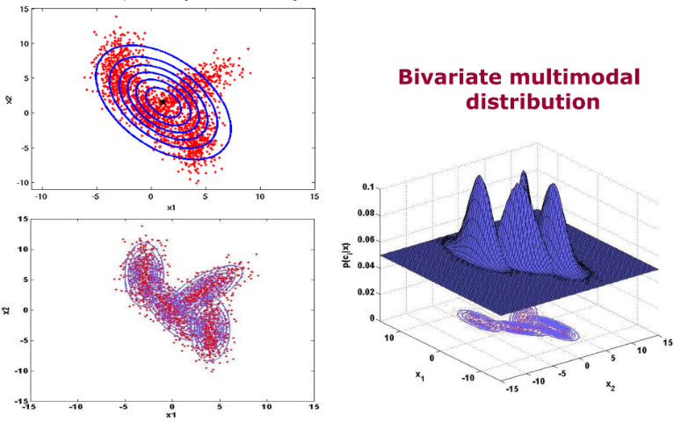
Normal Distribution
Probability density function: For continuous random variables
Probability mass function: For discrete random variables,
Univariate, Multivariate
Unimodal, Multimodal

Slide 10
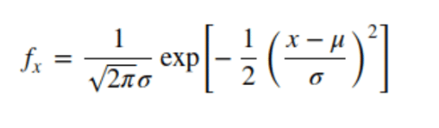
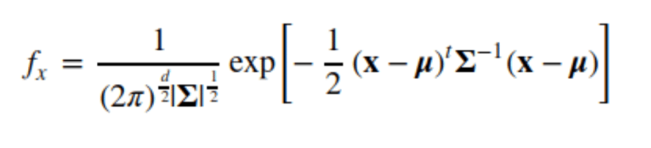
Normal distribution - continued

Slide 11
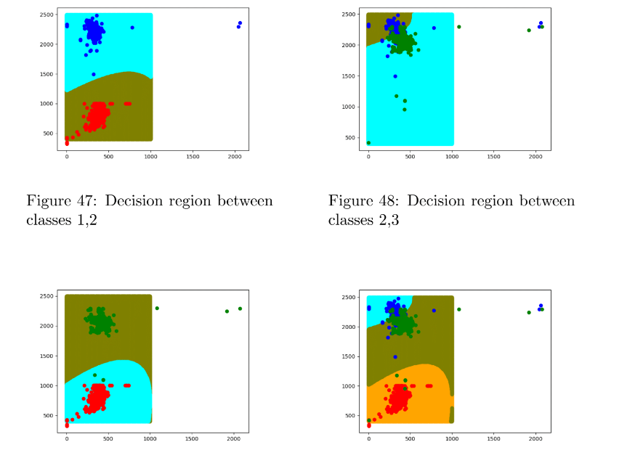
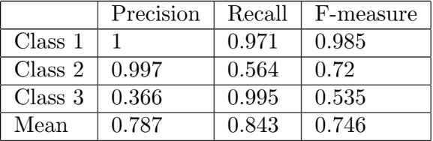
Naïve Bayes
Real Data
Accuracy: 77%

Slide 12
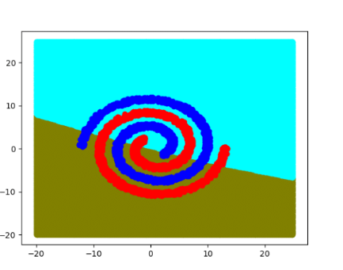
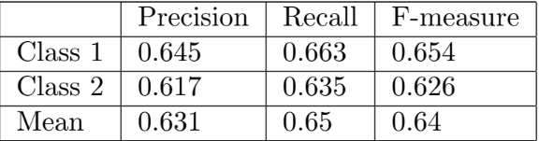
Naïve Bayes
Linearly non separable data
Accuracy: 63%

Slide 13



Random Variable
Possible values are outcome of random phenomenon
Expectation: Long run average value of a Random variable on repetitions of the experiment.
Variance: Expected value of the squared deviation from mean.
Co-variance: Measure of joint variability of two random variables (It shows tendency in the linear relation ship b/w the RVs) When normalised, correlation coefficient, the magnitude shows the strength of linear relation.

Slide 14

Conditional Probability
Measure of probability of an event given that another event has occurred.

Slide 15
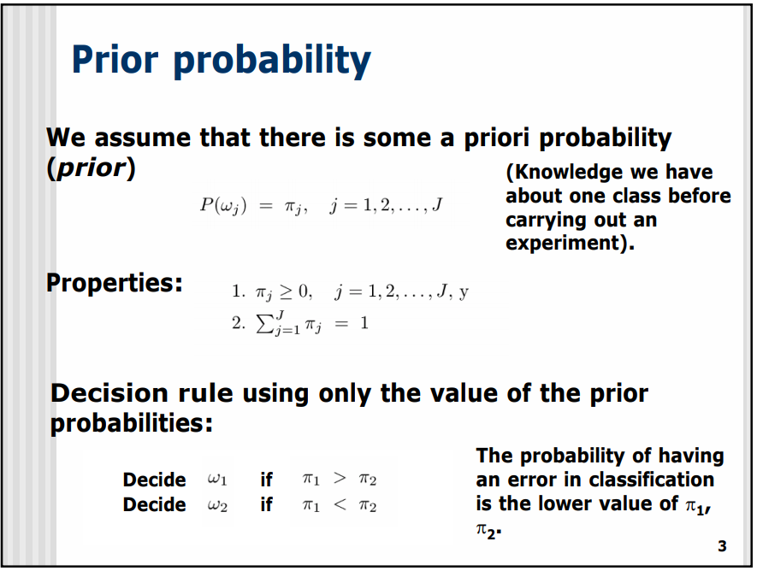

Slide 16
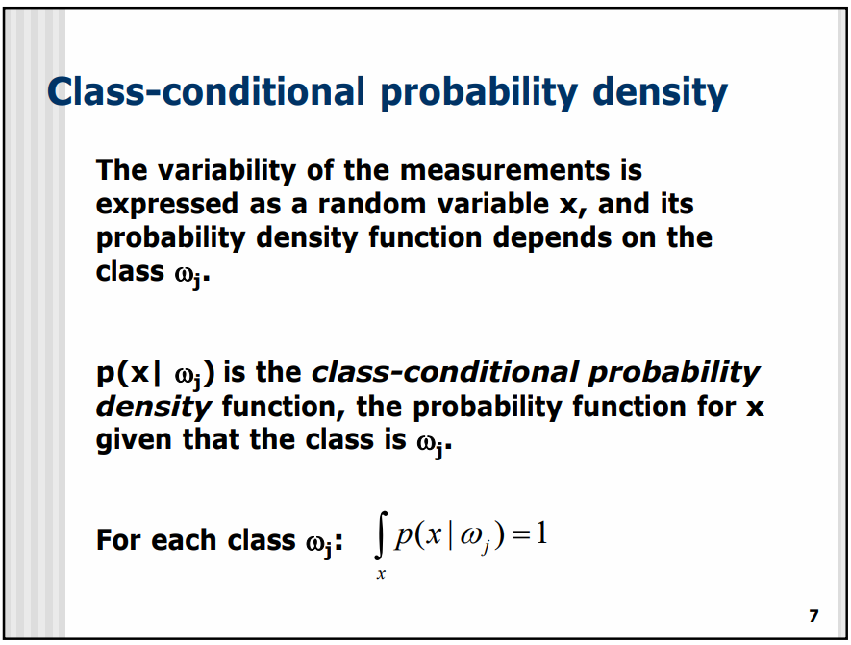

Slide 17
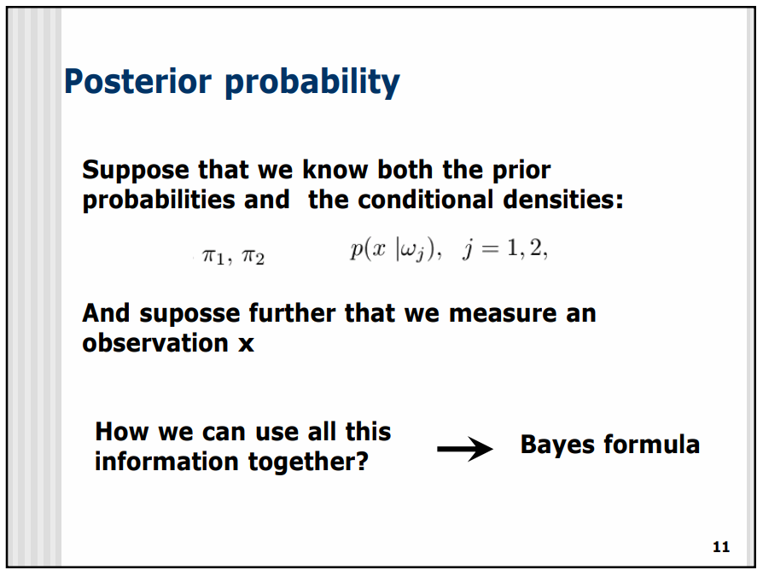

Slide 18
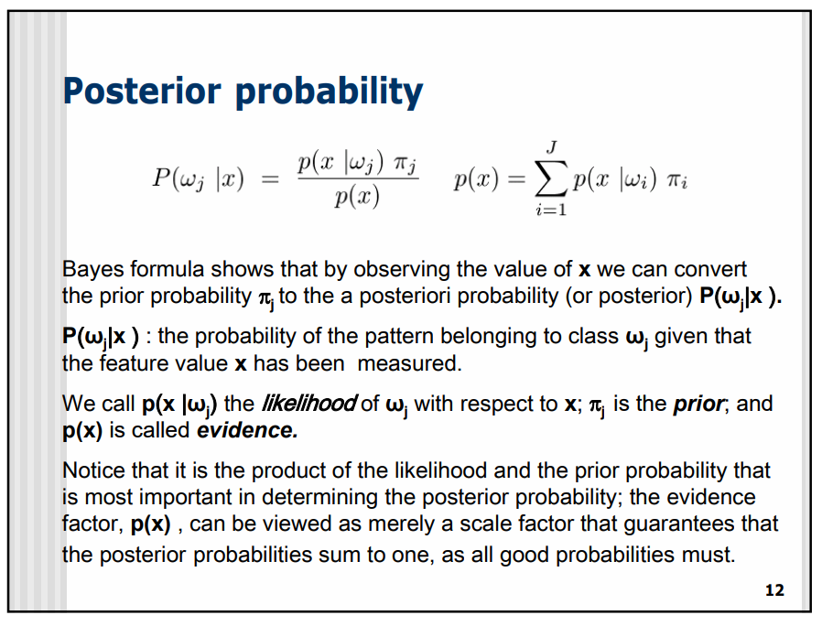

Slide 19
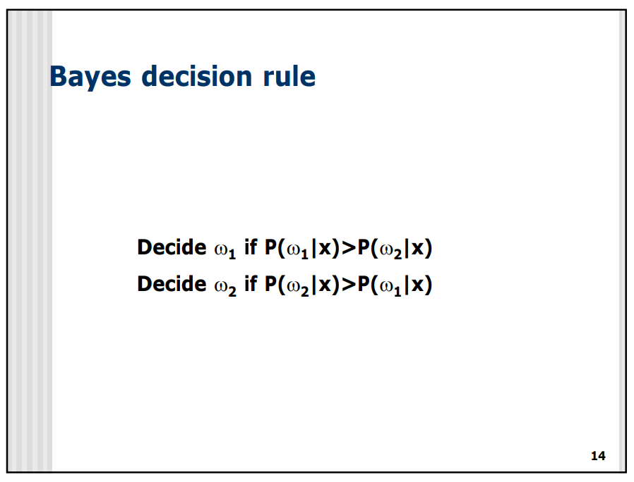

Slide 20
K-means clustering (unsupervised)
The algorithm works iteratively to assign each data point to one of K groups based on the features that are provided.
Data points are clustered based on feature similarity.
It is a method of vector quantization

Slide 21
Algorithm
The algorithms starts with initial estimates for the centroids, which can either be randomly generated or randomly selected from the data set. The algorithm then iterates between two steps:
Data assignment step: Each centroid defines one of the clusters. In this step, each data point is assigned to its nearest centroid, based on the squared Euclidean distance.
Centroid update step: In this step, the centroids are recomputed. This is done by taking the mean of all data points assigned to that centroid’s cluster.

Slide 22
Feature Extraction
24 component FV
64 component FV

Slide 23
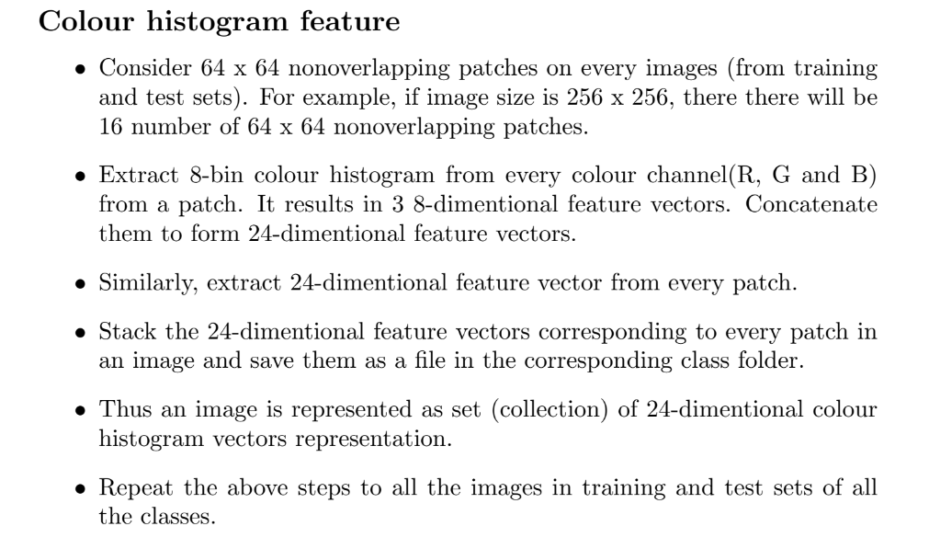

Slide 24
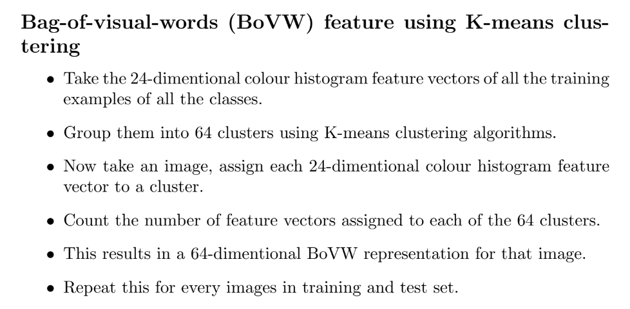

Slide 25
Goal
Finding parameters of distribution i.e. training model.
For example, the means in k-means
The models are complex and have lot of parameters

Slide 26
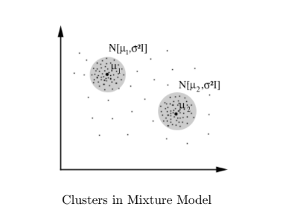
Gaussian Mixture Model
Dataset is modelled by a mixture of distribution.
Component Distribution, it covers if dominant patterns are captured b component distribution.

Slide 27
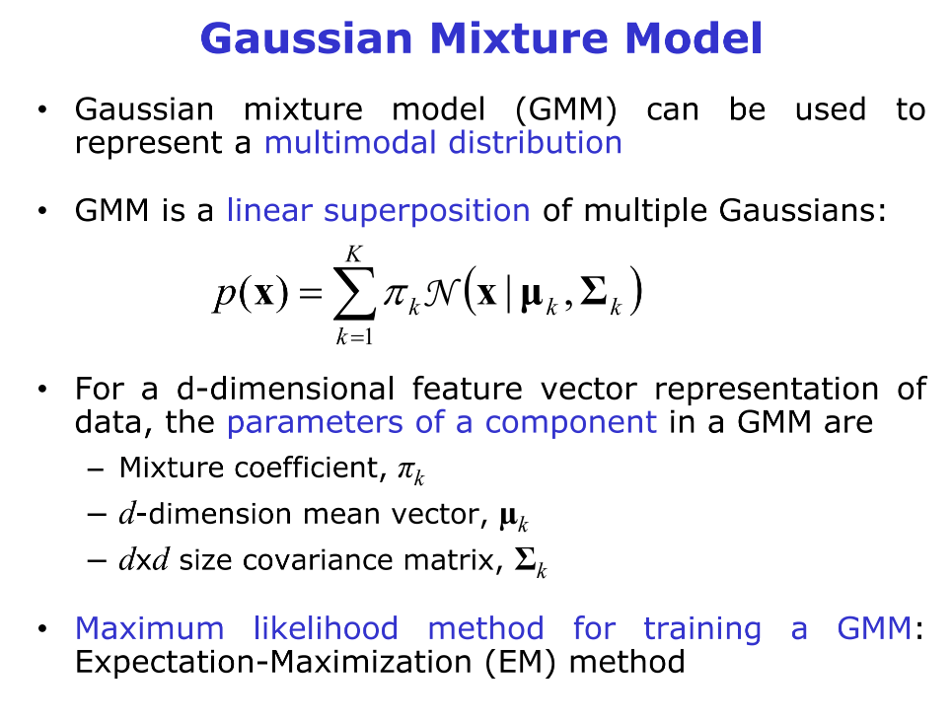

Slide 28
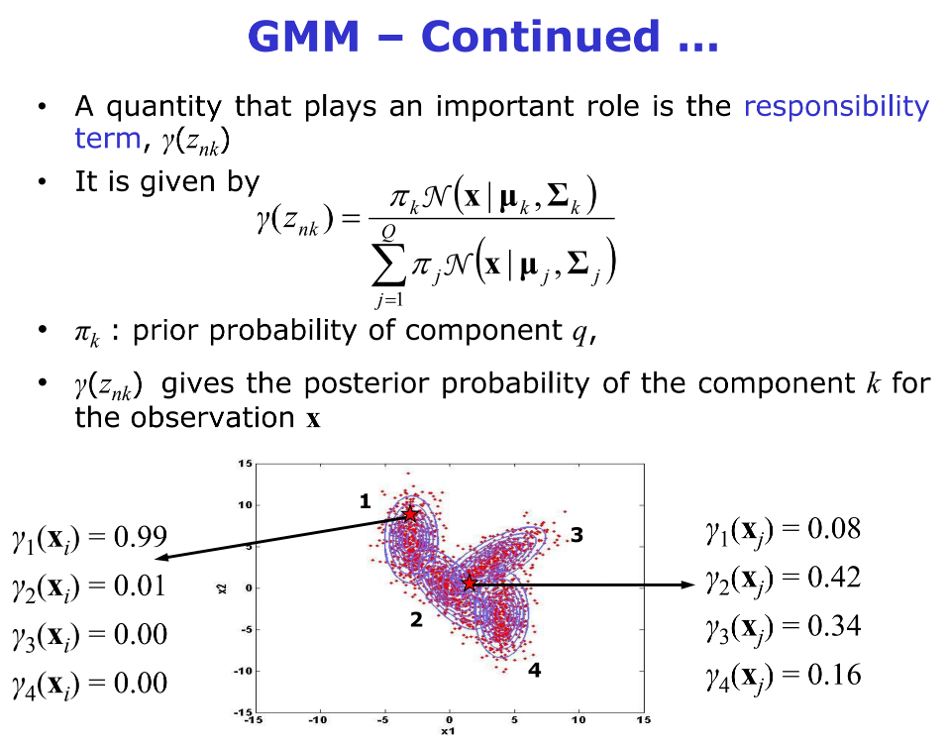

Slide 29
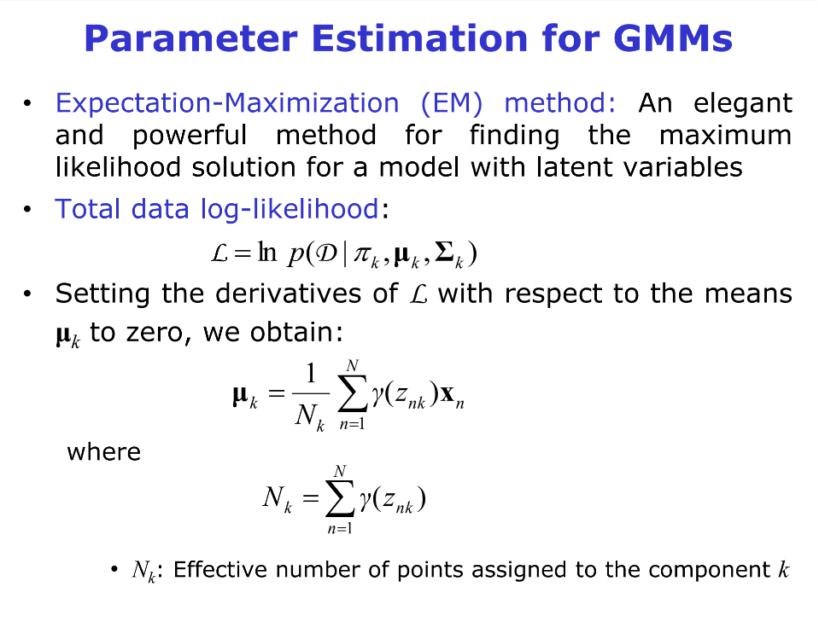

Slide 30
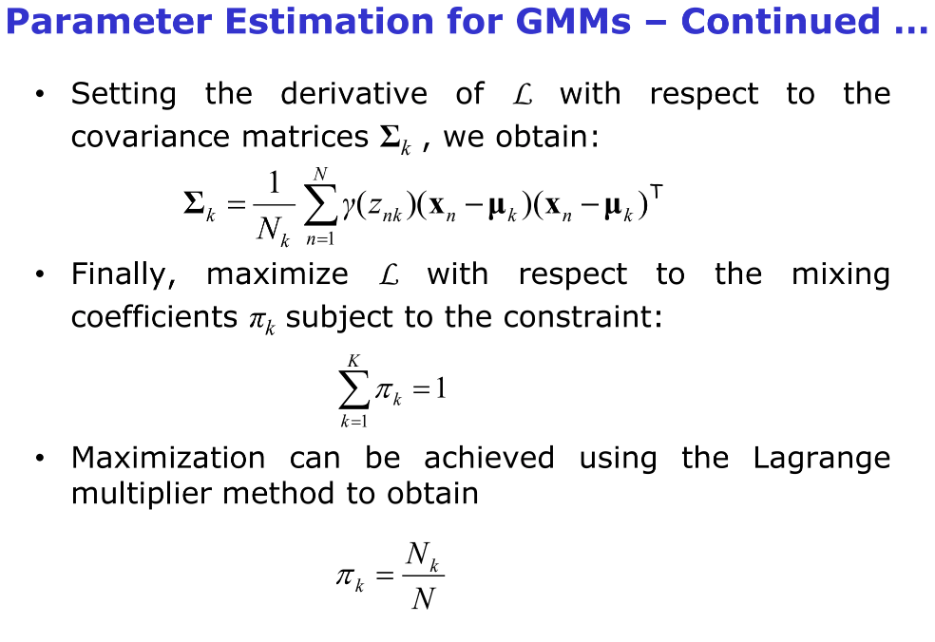

Slide 31
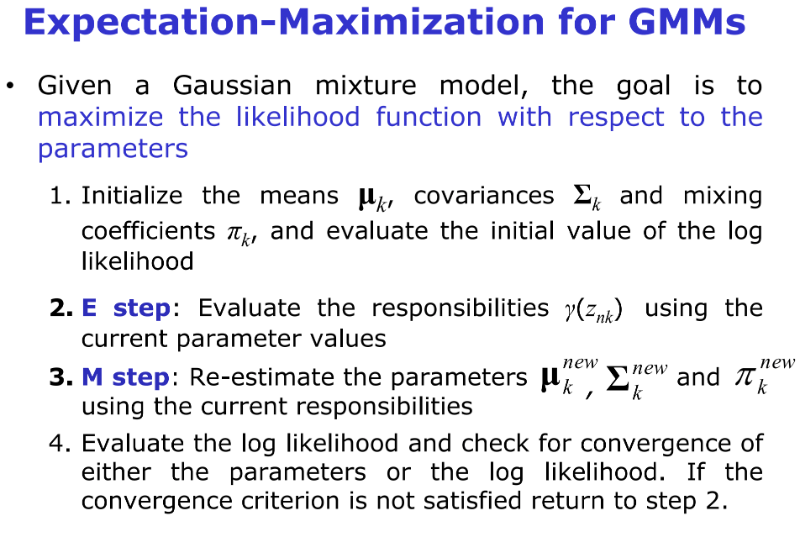

Slide 32
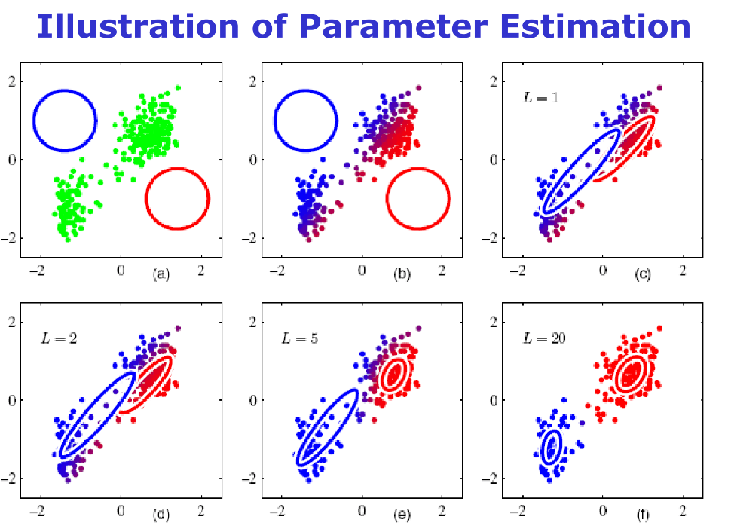

Slide 33
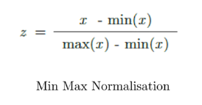
Problems faced in GMM
Large determinants of Covariance matrixes
Solution: feature scaling
Used min-max normalisation

Slide 34
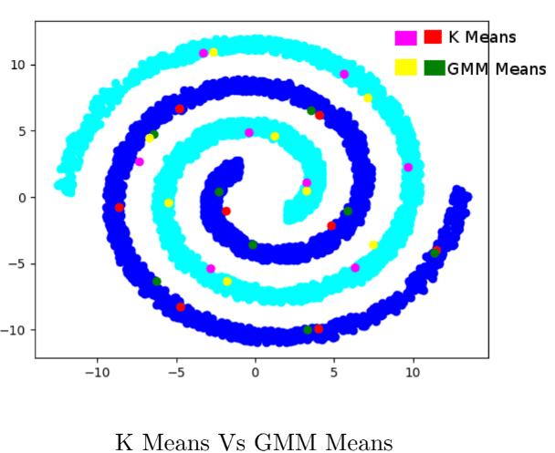
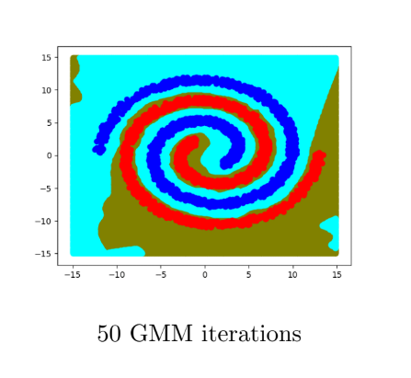
Accuracy: 100%

Slide 35
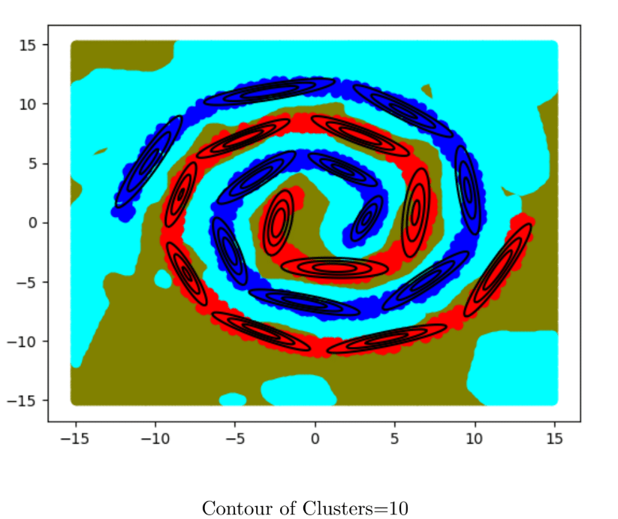

Slide 36
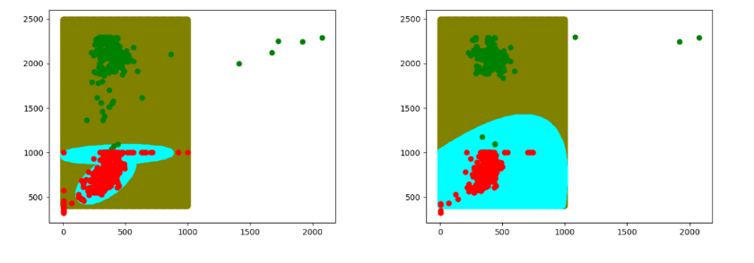
GMM vs Naïve Bayes
Accuracy (GMM): 87%
Accuracy (NB): 77%

Slide 37
Dynamic Time Warping

Slide 38
Nearest neighbour classification
K-nearest neighbour method

Slide 39
Markov Model

Slide 40
Hidden Markov Model​ (DHMM & CHMM)

Slide 41
Baum Welch – EM for HMM

Slide 42
Viterbi algorithm

Slide 43

The curse of Dimensionality
For a datasets with feature vectors having more number of dimensions, we need to calculate more number of parameters. E.g. for multimodal Gaussian Mixture Model with K mixtures
Hence larger d requires calculation of larger number of parameters which requires more training data. Since training data is not always large, we use dimensionality reduction techniques like PCA and FDA.

Slide 44
Principal Component Analysis

Slide 45
Fisher Discriminant Analysis

Slide 46

Perceptron (Supervised learning)
It is an algorithm for binary classifiers . It is a type of linear classifier, i.e. a classification algorithm that makes its predictions based on a linear predictor function combining a set of weights with the feature vector.
Perceptron learning consists of following steps: 1. initialize values of w and b 2. Compute error 3. Try and move in the direction that minimizes error

Slide 47
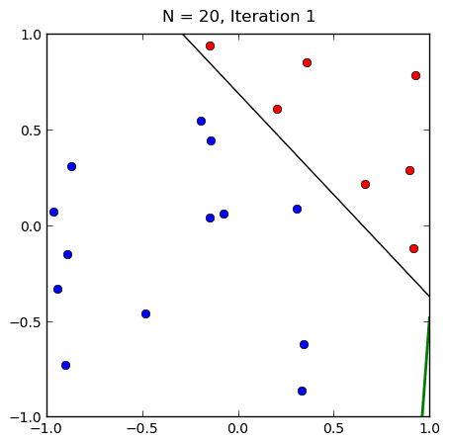
Perceptron (Supervised learning) - continued
Only for linearly separable.
Suffers from local minima problem.
Finding the separating hyperplane, not necessary optimal

Slide 48
Support vector machine​

Slide 49

Any Questions

Slide 50
Refrences
https://www.coursera.org/learn/machine-learning
https://en.wikipedia.org/wiki/Machine_learning
https://www.forbes.com/sites/quora/2017/05/10/the-best-practices-for-training-machine-learning-models/#7988a5cf7de8
http://proceedings.mlr.press/v67/li17a/li17a.pdf
https://en.wikipedia.org/wiki/Confusion_matrix
https://www.analyticsvidhya.com/blog/2017/09/common-machine-learning-algorithms/
Course Slides and Assignment Reports, Pattern Recognition, IIT Mandi

Slide 51
References - continued
https://www.math.uci.edu/~yqi/lect/Patternrecognition3.pdf

